Slide 1
Data Guild
Introduction
KROLL BOND RATING AGENCY, INC

Slide 2
Internal Organization
Goals
Raise Level
Knowledge Transfer
Top Down
Outside In
Peer to Peer
Explore
New Technology
New Methodologies
Pillars
Transparency
Inspection
Adaptation
Values
Commitment
Courage
Focus
Openness
Respect
Agenda
Introduction
Pete
Input
Attendees
Data Team
Ravi

Slide 3
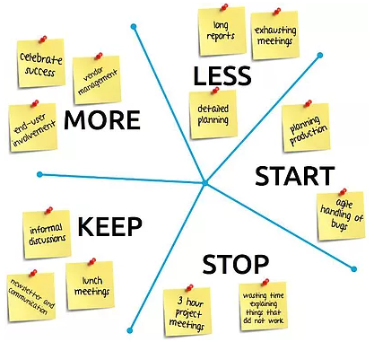
Continuous Improvement

